Slide 1
HighCloud Airlines analysis
By Group-4

Slide 2

HighCloud Airlines analysis
Introduction
Dashboard Overview
Conclusion & Suggestion
Challenges_Data_model
Project Scope
OverView
By Group-4

Slide 3
Business Overview
HighCloud Airlines, is leading airlines in the Aviation sector with vast network operations serving in term of reliability, safety & customers satisfaction who preferred company offers as that market trends and its operation Performance.
Decision Making
Resource Allocation
Passengers Experience
LoadFactor Growth
Insights:
Based on available data, we have analysed a total airlines carriers operating across specified regions
simultaneously Year wise growth in LoadFactor, addition to that passengers travelled more in mid of year i.e in the month Jun,Jul & August.
As per the data observed capacity of passengers is high on Weekdays compared to Weekends

Slide 4
HighCloud Airlines analysis
Project Overview
Tht
HighCloud Airlines aimed to leaverage the power of data analysis to extract valuable insights to optimise airlines operations and its performance globally.ttt Thtjtjtj
The Scope of t his project is analysing Key Performance Indicators to know a deeper understanding of:
By Group-4
KPI’z
Passengers Airlines Preference
Highest & Lowest Load Factor range: Yr:2008 LLF, Yr:2013 HLF
Operational Efficiency

Slide 5
Data model Challenges
Analyzing bulk volume of data, generated by HighCloud Airlines may strain resources & leads to impact in performance
Data may partial zed in different systems & departments which leads to inconsistences and accuracies
Highlighting the need for data optimization technique to load data
Overcoming these below challenges is crucial for accurate insights while loading in Analyzing Tools
Data volume & Data Quality
Complex Relationship: Connecting between different data tables

Slide 6

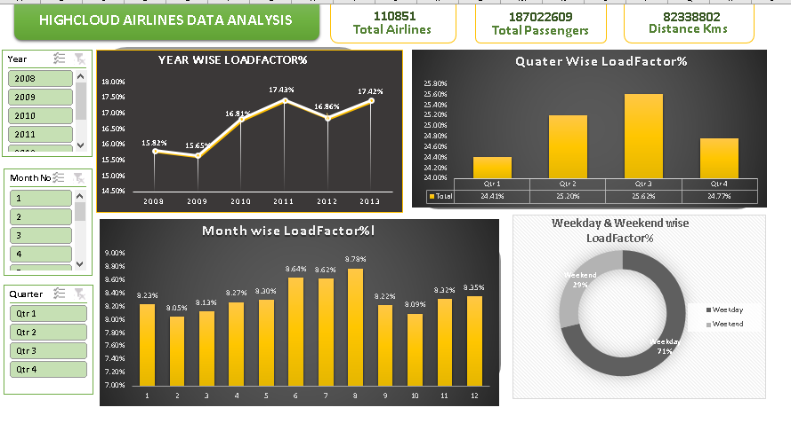
Dashboard Overview

Slide 7
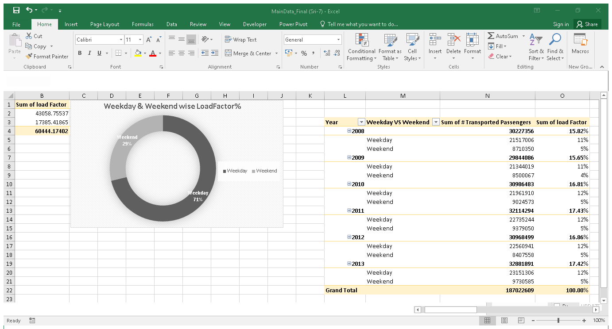

Slide 8
Suggestions & Conculsion
Initiatives/Competative Analysis
Route Optimization
CustomerExperiencec
Customer Service: Ensuring that service are friendly, responsive, promptly addressing Customer Queries to enhance customer satisfaction
Pricing: Consider offering promotions discounts to attract more customers in the market trend
Employee Training: Regular L&D training development programs enhance their skills
Safety & Security: Ensure giving priority protocals to the passengers were avail
Flight Experience: Ensure to get feedback from travelled passengers which it makes to change if any default
Feedback and Communication: Encouraging Passengers and getting feedback it tends to helps thedefault things which can improvise it for the next upcoming passengers small communication makes deifferent things
OverAll, focusing & improving on the lagging areas might it helps to give better service which were not expected by the passengers and to reach for the expections and satisfaction,
Timeing: Improving on time performance it optimize the passengers schedule and need tp keep informing them if any un-expected things changes
Digital Transformation
Safety & Compliance
Market Expension

Slide 9
Thank You.!!

